Slide 1





LAMATu, CONTROLLED
RELEASE TECHNOLOGY
FERTILIZER
&
fertilizing products

Slide 2

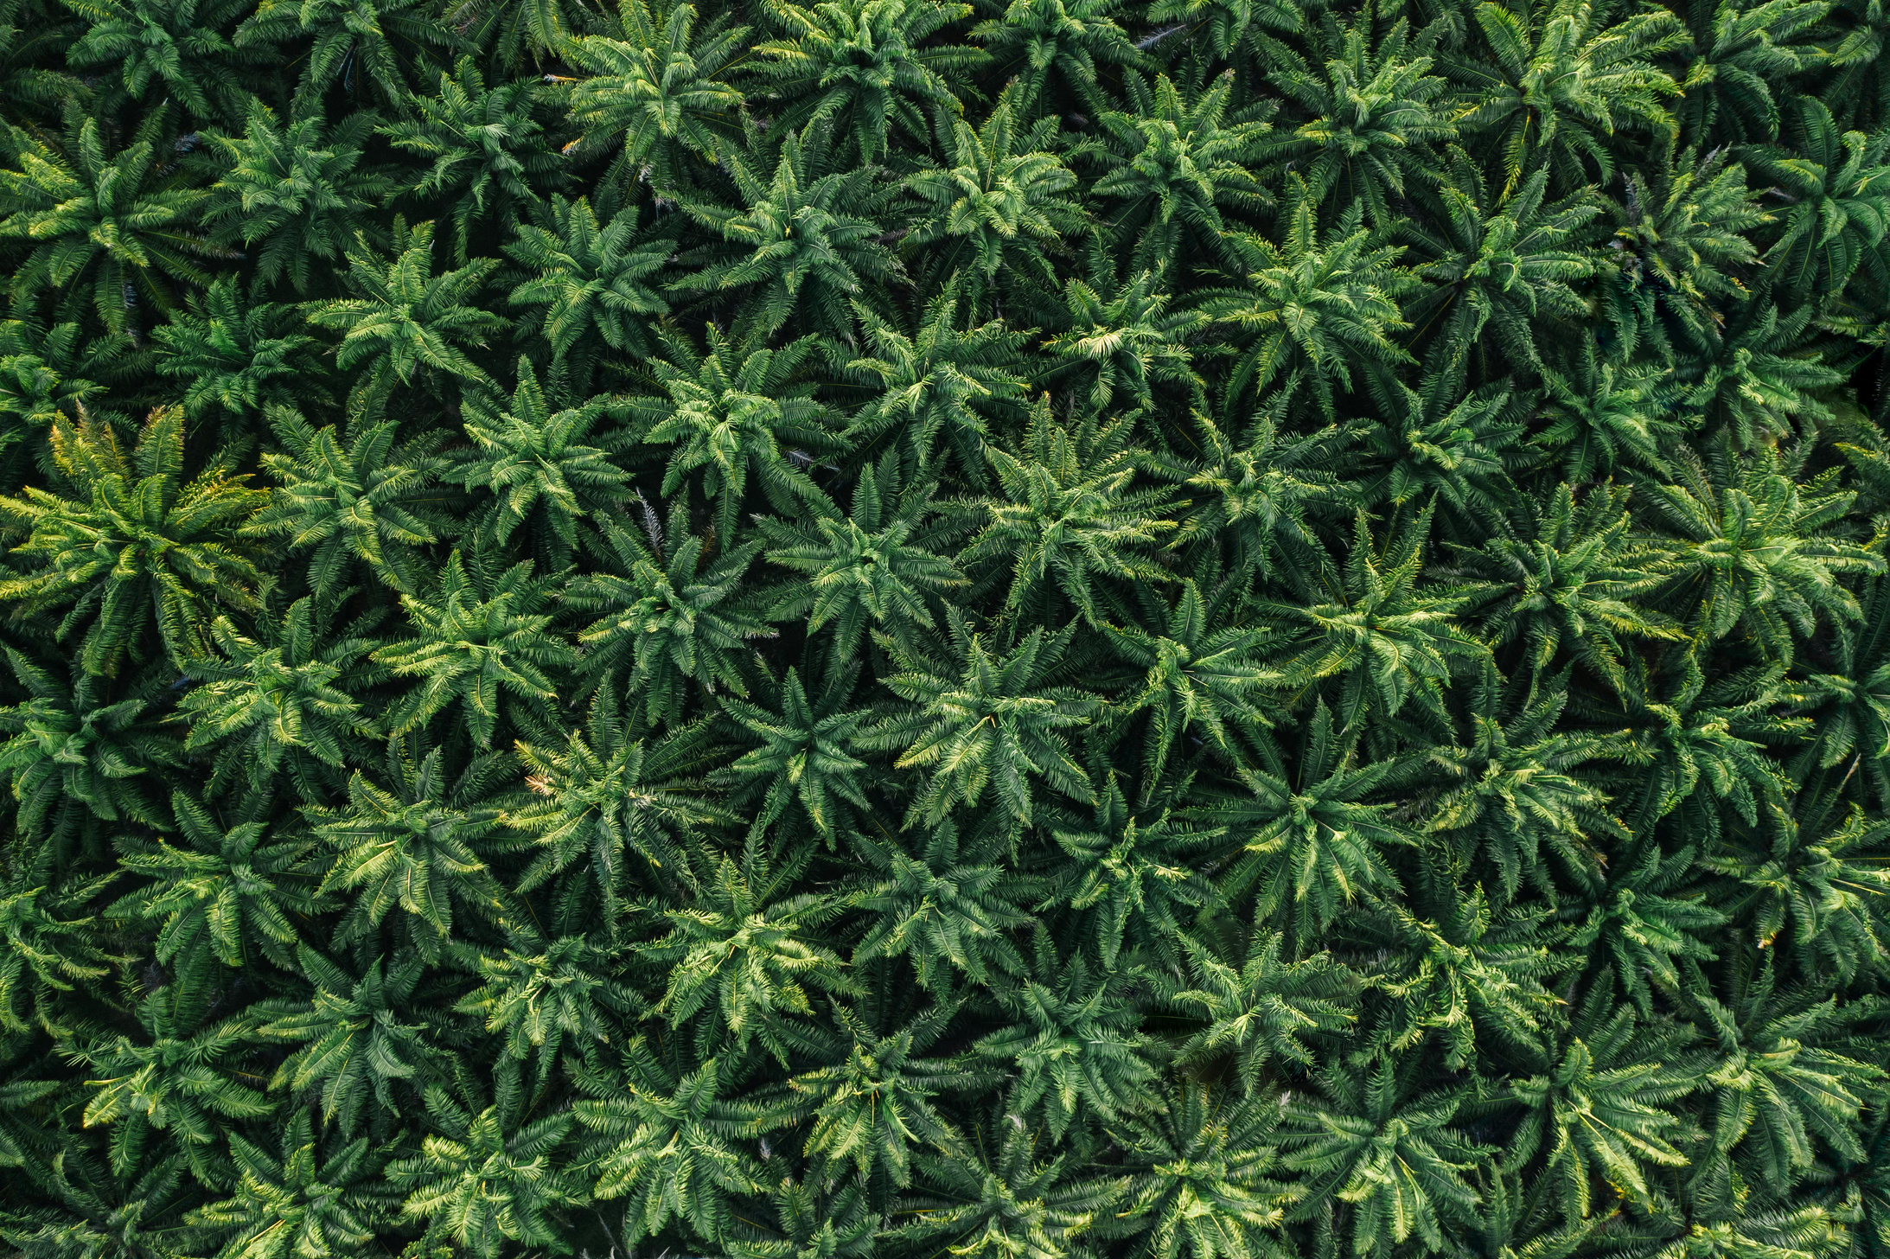
WHAT IS A
CRT-ENABLER
COATING MATERIAL?
COATED LAYER
NUTRIENT CORE
◉The nutrient core is NO LONGER NAKED!
It is enveloped by a coating material
◉ The coating material dissociates to release the nutrients
◉Time controlled release of nutrients offers continuous nutrient supply

Slide 3
LAMATu Series is a
CRT ENABLER
PRODUCT | LAMAtu by Nanofertech Sdn. Bhd. | Ajib CRF by Diversatech Fertilizer Sdn. Bhd. | CRT Sachet fertilizer by PlantSafe Sdn. Bhd.
Coating material | element | polymer | polymer
Dimension | nano | blk | bulk
Coupled to nutrient release predictive tool | yes | no | no
Form | granule | granule | sachet
Crop range | agricultural crops | oil palm | oil palm and rubber
Beneficial functional coat | yes | no | no
WORLD’S FIRST AI-POWERED CRT FOR
INFORMED NUTRIENT MANAGEMENT

Slide 4
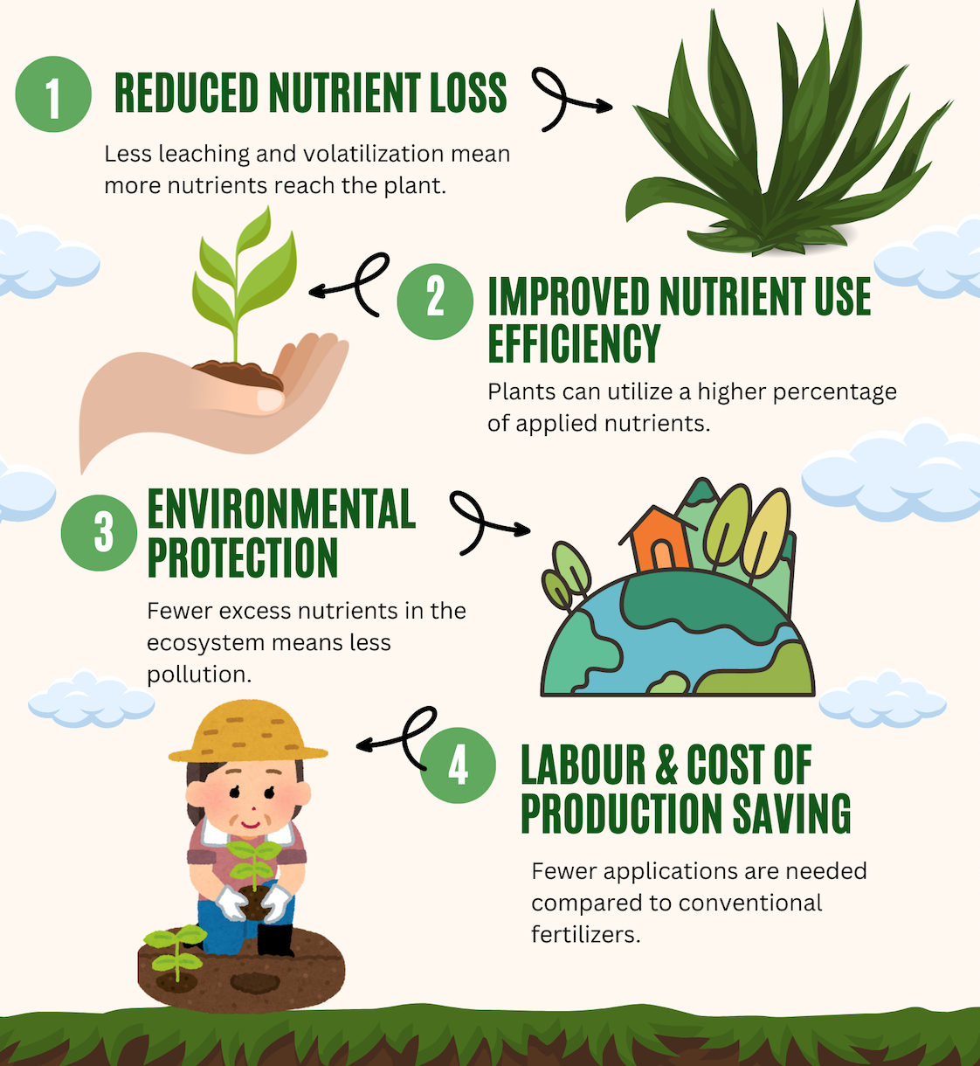
WHY SWITCH TO CRT-ENABLED FERTILIZER?

Slide 5
WHY LAMATu series: Your choice of CRT?
 | CONVENTIONAL FERTILIZER | CRT-ENABLED LAMATu
Fertilizer price | RM 2.00/kg | RM 5.00/kg
Split applications per tree/year | 4X | 1X
Input cost per tree/year | 8* n trees | 5*n trees
Labour | 3X*RM3/h | 1X*RM3/h
Labour cost per tree /year | 3*RM3/h* n trees | 1*RM3/h * n trees
reduces up to 37.5% of input cost
and 66% of labour cost
ONE TIME APPLICATION
ONE TIME LABOUR
LIFE-TIME ENVIRONMENTAL STEWARDSHIP

Slide 6
LAMAT environmental pledge
In Malaysia, the existing CRT’s technologies
are acquired through international patents
LAMATu series of CRT, is a
homegrown local invention
empowering the local agriculture scene
with its core value, sustainability
With a 1% nitrous oxide emission factor from
nitrogenous fertilizer,
LAMATu is able to reduce up to 75% of GHG
emission resulting from the fertilization of
1 hectare of oil palm plantation, annually

